Slide 1
Affiliation Networks

Slide 2
Two mode networks
Typically a network consists of a set of units of the same kind linked via some kind of relationship
  Person to person friendship ties
  Organization to organization alliances
  Airport to airport plane routes

Slide 3
Two mode networks
Typically a network consists of a set of units of the same kind linked via some kind of relationship
  Person to person friendship ties
  Organization to organization alliances
  Airport to airport plane routes
Sometimes a network is composed of relationships between two types of entities:
  Persons and groups they belong to
  Actors and the movies they appear in
  Scientists and papers they write

Slide 4
Two mode networks
Typically a network consists of a set of units of the same kind linked via some kind of relationship
  Person to person friendship ties
  Organization to organization alliances
  Airport to airport plane routes
Sometimes a network is composed of relationships between two types of entities:
  Persons and groups they belong to
  Actors and the movies they appear in
  Scientists and papers they write
These are called two-mode (or affiliation) networks
  Regular networks are therefore one-mode networks

Slide 5
Representing two mode networks as graphs
U
V
Two mode networks can be represented as bipartite graphs
A bipartite graph is a special kind of graph featuring:
  Two disjoint sets of vertices, U, V
    Two sets are disjoint when they don’t share members
  Edges link vertices between sets but not within sets
  Affiliation or membership relations are undirected
  The two sets can be of different cardinality (size)! (|U| = 6, |V| = 5)
Gabriela
Super Smash Bros.
Parker
Cheese
Brandon
Nerdfighters
Marie
Magic
Rahul
Fashion
Minjoo

Slide 6
Form bipartite graph to affiliation matrix
Gabriela
Super Smash Bros.
 | Super Smash Bros. | Cheese | Nerd- Fighters | Magic | Fashion
Gabriela
Parker
Brandon
Marie
Rahul
Minjoo
Parker
Cheese
Brandon
Nerdfighters
Marie
Magic
Rahul
Fashion
Minjoo
An affiliation matrix (A) has number of rows equals to the number of people and number of columns equal to the number of groups!

Slide 7
Form bipartite graph to affiliation matrix
Gabriela
Super Smash Bros.
 | Super Smash Bros. | Cheese | Nerd- Fighters | Magic | Fashion
Gabriela
Parker
Brandon
Marie
Rahul
Minjoo
Parker
Cheese
Brandon
Nerdfighters
Marie
Magic
Rahul
Fashion
Minjoo
Because the number of people does not have to be the same as the number of groups affiliation matrices are usually rectangular not square like adjacency matrices

Slide 8
Form bipartite graph to affiliation matrix
Gabriela
Super Smash Bros.
 | Super Smash Bros. | Cheese | Nerd- Fighters | Magic | Fashion
Gabriela
Parker
Brandon
Marie
Rahul
Minjoo
Parker
Cheese
Brandon
Nerdfighters
Marie
Magic
Rahul
Fashion
Minjoo
We fill out the affiliation matrix just like we did the adjacency matrix: Cell A_{ij} = 1 if person i is affiliated with group j. Otherwise A_{ij} = 0.

Slide 9
Form bipartite graph to affiliation matrix
Gabriela
Super Smash Bros.
 | Super Smash Bros. | Cheese | Nerd- Fighters | Magic | Fashion
Gabriela | 1 | 0 | 1 | 0 | 1
Parker
Brandon
Marie
Rahul
Minjoo
Parker
Cheese
Brandon
Nerdfighters
Marie
Magic
Rahul
Fashion
Minjoo
So Gabriela gets a one in the columns corresponding to the Super Smash Bros., Nerdfighters, and the Fashion Club

Slide 10
Form bipartite graph to affiliation matrix
Gabriela
Super Smash Bros.
 | Super Smash Bros. | Cheese | Nerd- Fighters | Magic | Fashion
Gabriela | 1 | 0 | 1 | 0 | 1
Parker | 0 | 1 | 0 | 1 | 0
Brandon | 0 | 1 | 0 | 0 | 0
Marie | 1 | 0 | 1 | 0 | 0
Rahul | 0 | 1 | 0 | 0 | 1
Minjoo | 0 | 1 | 0 | 1 | 1
Parker
Cheese
Brandon
Nerdfighters
Marie
Magic
Rahul
Fashion
Minjoo
This is the full affiliation matrix corresponding to the bipartite graph on the right

Slide 11
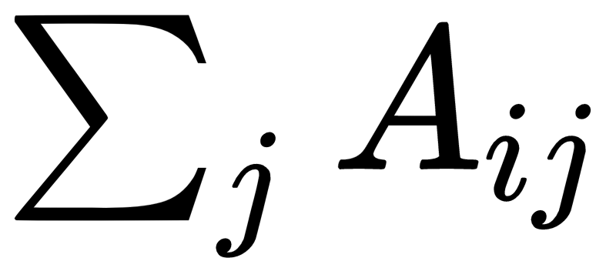
Form bipartite graph to affiliation matrix
Gabriela
Super Smash Bros.
 | Super Smash Bros. | Cheese | Nerd- Fighters | Magic | Fashion
Gabriela | 1 | 0 | 1 | 0 | 1
Parker | 0 | 1 | 0 | 1 | 0
Brandon | 0 | 1 | 0 | 0 | 0
Marie | 1 | 0 | 1 | 0 | 0
Rahul | 0 | 1 | 0 | 0 | 1
Minjoo | 0 | 1 | 0 | 1 | 1
Parker
Cheese
3
2
1
2
2
3
Brandon
Nerdfighters
Marie
Magic
Rahul
Fashion
Minjoo
The row sums of the affiliation matrix gives us the number of each memberships each person has!

Slide 12
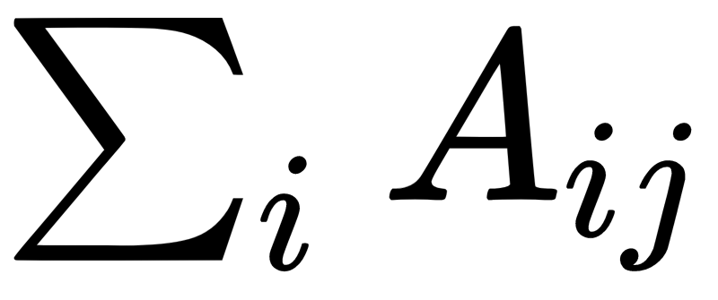
Form bipartite graph to affiliation matrix
Gabriela
Super Smash Bros.
 | Super Smash Bros. | Cheese | Nerd- Fighters | Magic | Fashion
Gabriela | 1 | 0 | 1 | 0 | 1
Parker | 0 | 1 | 0 | 1 | 0
Brandon | 0 | 1 | 0 | 0 | 0
Marie | 1 | 0 | 1 | 0 | 0
Rahul | 0 | 1 | 0 | 0 | 1
Minjoo | 0 | 1 | 0 | 1 | 1
Parker
Cheese
Brandon
Nerdfighters
Marie
Magic
Rahul
Fashion
Minjoo
The column sums of the affiliation matrix gives us the size of each group!
2 | 4 | 2 | 2 | 3

Slide 13
Matrix Operations: The Transpose
The transpose (' or ^{T}) of a matrix reverses the row and column dimensions.
  A g x h matrix becomes a h x g matrix
  The number of rows of the transpose A^{T} is the number of columns of the original A
  The number of columns of the transpose A^{T} is the number of rows of the original A
A
A^{T}
a | b
c | d
e | f
a | c | e
b | d | f
2 X 3
3 X 2
A_{ij}^{T}= A_{ji}

Slide 14
A matrix (A) and its transpose (A^{T})
 | Super Smash Bros. | Cheese | Nerd- Fighters | Magic | Fashion
Gabriela | 1 | 0 | 1 | 0 | 1
Parker | 0 | 1 | 0 | 1 | 0
Brandon | 0 | 1 | 0 | 0 | 0
Marie | 1 | 0 | 1 | 0 | 0
Rahul | 0 | 1 | 0 | 0 | 1
Minjoo | 0 | 1 | 0 | 1 | 1
 | Gabriela | Parker | Brandon | Marie | Rahul | Minjoo
Super Smash | 1 | 0 | 0 | 1 | 0 | 0
Cheese | 0 | 1 | 1 | 0 | 1 | 1
Nerd- Fighters | 1 | 0 | 0 | 1 | 0 | 0
Magic | 0 | 1 | 0 | 0 | 0 | 1
Fashion | 1 | 0 | 0 | 0 | 1 | 1
A_{(6 x 5)}
A^{T}_{(5 x 6)}

Slide 15
A matrix (A) and its transpose (A^{T})
The transpose of a matrix is the same matrix with the rows and columns switched around!
 | Super Smash Bros. | Cheese | Nerd- Fighters | Magic | Fashion
Gabriela | 1 | 0 | 1 | 0 | 1
Parker | 0 | 1 | 0 | 1 | 0
Brandon | 0 | 1 | 0 | 0 | 0
Marie | 1 | 0 | 1 | 0 | 0
Rahul | 0 | 1 | 0 | 0 | 1
Minjoo | 0 | 1 | 0 | 1 | 1
 | Gabriela | Parker | Brandon | Marie | Rahul | Minjoo
Super Smash Bros. | 1 | 0 | 0 | 1 | 0 | 0
Cheese | 0 | 1 | 1 | 0 | 1 | 1
Nerd- Fighters | 1 | 0 | 0 | 1 | 0 | 0
Magic | 0 | 1 | 0 | 0 | 0 | 1
Fashion | 1 | 0 | 0 | 0 | 1 | 1
A_{(6 x 5)}
A’_{(5 x 6)}

Slide 16
Matrix Operations: Matrix Multiplication
A_{4 x 2} ✕ B_{2 x 3}
A_{4 x 3} ✕ B_{2 x 3}
Inner dimensions
Inner dimensions
Outer dimensions
.
Outer dimensions
.
B _{2 x 3}
B _{2 x 3}
A _{4 x 3}
A _{4 x 2}

Slide 17
Matrix Operations: Matrix Multiplication
A_{4 x 2} ✕ B_{2 x 3}
A_{4 x 3} ✕ B_{2 x 3}
Inner dimensions match! Matrices are conformable
Inner dimensions don’t match! Matrices are not conformable
Inner dimensions
Inner dimensions
Outer dimensions
.
Outer dimensions
.
B _{2 x 3}
B _{2 x 3}
A _{4 x 3}
A _{4 x 2}

Slide 18


Matrix Operations: Matrix Multiplication
A_{4 x 2} ✕ B_{2 x 3}
A_{4 x 3} ✕ B_{2 x 3}
Inner dimensions match! Matrices are conformable
Inner dimensions don’t match! Matrices are not conformable
Inner dimensions
Inner dimensions
Outer dimensions
.
Outer dimensions
.
B _{2 x 3}
B _{2 x 3}
A _{4 x 3}
A _{4 x 2}

Slide 19
Matrix Operations: Matrix Multiplication
A_{4 x 2} ✕ B_{2 x 3}
A_{4 x 3} ✕ B_{2 x 3}
Inner dimensions match! Matrices are conformable
Inner dimensions don’t match! Matrices are not conformable
Inner dimensions
Inner dimensions
Outer dimensions
.
Outer dimensions
.
B _{2 x 3}
B _{2 x 3}
A _{4 x 3}
A _{4 x 2}

Slide 20
Matrix Operations: Matrix Multiplication
A_{4 x 2} ✕ B_{2 x 3}
A_{4 x 3} ✕ B_{2 x 3}
Inner dimensions match! Matrices are conformable
Inner dimensions don’t match! Matrices are not conformable
Inner dimensions
Inner dimensions
Outer dimensions
.
Outer dimensions
.
In general you can multiply any A_{m x n} matrix ✕ any B _{q x p} matrix:
  So long as n = q
  It doesn’t matter what the values of the outer dimensions is

Slide 21
Matrix Operations: Matrix Multiplication
A_{4 x 2} ✕ B_{2 x 3}
A_{4 x 3} ✕ B_{2 x 3}
Inner dimensions match! Matrices are conformable
Inner dimensions don’t match! Matrices are not conformable
Inner dimensions
Inner dimensions
Outer dimensions
.
Outer dimensions
.
In general you can multiply any A_{m x n} matrix ✕ any B _{q x p} matrix:
  So long as n = q
  It doesn’t matter what the values of the outer dimensions is

Slide 22
Matrix Operations: Matrix Multiplication
A_{3 x 2} ✕ B_{2 x 4} = C_{3 x 4}
A_{3 x 2} ✕ B_{3 x 4} = Not defined
Inner dimensions
Inner dimensions
Product matrix C is 3 X 4 same as the outer dimensions
Outer dimensions
.
Outer dimensions
.
The outer dimensions determine the dimensions of the resulting matrix such that A_{m x n} ✕ B _{q x p} = C _{m x p}

Slide 23
Matrix Operations: Matrix Multiplication
Turns out that the product of any matrix (A) times its transpose (A^{T}) is always defined!
So is the product of the transpose (A^{T}) times the original matrix (A)!
A_{3 x 2} x A^{T}_{2 x 3} = C_{3 x 3}
A^{T}_{2 x 3} x A_{3 x 2} = C_{2 x 2}
Inner dims. match!
Inner dims. match!
Outer dims.
Outer dims.

Slide 24
Affiliation matrix -> Co-membership matrix
 | Super Smash Bros. | Cheese | Nerd- Fighters | Magic | Fashion
Gabriela | 1 | 0 | 1 | 0 | 1
Parker | 0 | 1 | 0 | 1 | 0
Brandon | 0 | 1 | 0 | 0 | 0
Marie | 1 | 0 | 1 | 0 | 0
Rahul | 0 | 1 | 0 | 0 | 1
Minjoo | 0 | 1 | 0 | 1 | 1
 | Gabriela | Parker | Brandon | Marie | Rahul | Minjoo
Super Smash Bros. | 1 | 0 | 0 | 1 | 0 | 0
Cheese | 0 | 1 | 1 | 0 | 1 | 1
Nerd- Fighters | 1 | 0 | 0 | 1 | 0 | 0
Magic | 0 | 1 | 0 | 0 | 0 | 1
Fashion | 1 | 0 | 0 | 0 | 1 | 1
A^{T}
A
✕
 | Gabriela | Parker | Brandon | Marie | Rahul | Minjoo
Gabriela
Parker
Brandon
Marie
Rahul
Minjoo
=
C

Slide 25
Affiliation matrix -> Co-membership matrix
 | Super Smash Bros. | Cheese | Nerd- Fighters | Magic | Fashion
Gabriela | 1 | 0 | 1 | 0 | 1
Parker | 0 | 1 | 0 | 1 | 0
Brandon | 0 | 1 | 0 | 0 | 0
Marie | 1 | 0 | 1 | 0 | 0
Rahul | 0 | 1 | 0 | 0 | 1
Minjoo | 0 | 1 | 0 | 1 | 1
 | Gabriela | Parker | Brandon | Marie | Rahul | Minjoo
Super Smash Bros. | 1 | 0 | 0 | 1 | 0 | 0
Cheese | 0 | 1 | 1 | 0 | 1 | 1
Nerd- Fighters | 1 | 0 | 0 | 1 | 0 | 0
Magic | 0 | 1 | 0 | 0 | 0 | 1
Fashion | 1 | 0 | 0 | 0 | 1 | 1
A^{T}
A
✕
 | Gabriela | Parker | Brandon | Marie | Rahul | Minjoo
Gabriela |  | 0
Parker
Brandon
Marie
Rahul
Minjoo
= (1 * 0) + (0 * 1) + (1 * 0) + (0 * 1) + (1 * 0)
=
C

Slide 26
Affiliation matrix -> Co-membership matrix
 | Super Smash Bros. | Cheese | Nerd- Fighters | Magic | Fashion
Gabriela | 1 | 0 | 1 | 0 | 1
Parker | 0 | 1 | 0 | 1 | 0
Brandon | 0 | 1 | 0 | 0 | 0
Marie | 1 | 0 | 1 | 0 | 0
Rahul | 0 | 1 | 0 | 0 | 1
Minjoo | 0 | 1 | 0 | 1 | 1
 | Gabriela | Parker | Brandon | Marie | Rahul | Minjoo
Super Smash Bros. | 1 | 0 | 0 | 1 | 0 | 0
Cheese | 0 | 1 | 1 | 0 | 1 | 1
Nerd- Fighters | 1 | 0 | 0 | 1 | 0 | 0
Magic | 0 | 1 | 0 | 0 | 0 | 1
Fashion | 1 | 0 | 0 | 0 | 1 | 1
A^{T}
A
✕
 | Gabriela | Parker | Brandon | Marie | Rahul | Minjoo
Gabriela |  | 0
Parker | 0
Brandon
Marie
Rahul
Minjoo
= (0 * 1) + (1 * 0) + (0 * 1) + (1 * 0) + (0 * 1)
=
C

Slide 27
Affiliation matrix -> Co-membership matrix
 | Super Smash Bros. | Cheese | Nerd- Fighters | Magic | Fashion
Gabriela | 1 | 0 | 1 | 0 | 1
Parker | 0 | 1 | 0 | 1 | 0
Brandon | 0 | 1 | 0 | 0 | 0
Marie | 1 | 0 | 1 | 0 | 0
Rahul | 0 | 1 | 0 | 0 | 1
Minjoo | 0 | 1 | 0 | 1 | 1
 | Gabriela | Parker | Brandon | Marie | Rahul | Minjoo
Super Smash Bros. | 1 | 0 | 0 | 1 | 0 | 0
Cheese | 0 | 1 | 1 | 0 | 1 | 1
Nerd- Fighters | 1 | 0 | 0 | 1 | 0 | 0
Magic | 0 | 1 | 0 | 0 | 0 | 1
Fashion | 1 | 0 | 0 | 0 | 1 | 1
A^{T}
A
✕
 | Gabriela | Parker | Brandon | Marie | Rahul | Minjoo
Gabriela |  | 0 |  | 2
Parker | 0
Brandon
Marie | 2
Rahul
Minjoo
= (1 * 1) + (0 * 0) + (1 * 1) + (0 * 0) + (1 * 0)
=
C

Slide 28
Affiliation matrix -> Co-membership matrix
 | Super Smash Bros. | Cheese | Nerd- Fighters | Magic | Fashion
Gabriela | 1 | 0 | 1 | 0 | 1
Parker | 0 | 1 | 0 | 1 | 0
Brandon | 0 | 1 | 0 | 0 | 0
Marie | 1 | 0 | 1 | 0 | 0
Rahul | 0 | 1 | 0 | 0 | 1
Minjoo | 0 | 1 | 0 | 1 | 1
 | Gabriela | Parker | Brandon | Marie | Rahul | Minjoo
Super Smash Bros. | 1 | 0 | 0 | 1 | 0 | 0
Cheese | 0 | 1 | 1 | 0 | 1 | 1
Nerd- Fighters | 1 | 0 | 0 | 1 | 0 | 0
Magic | 0 | 1 | 0 | 0 | 0 | 1
Fashion | 1 | 0 | 0 | 0 | 1 | 1
A^{T}
A
✕
 | Gabriela | Parker | Brandon | Marie | Rahul | Minjoo
Gabriela | 3 | 0 |  | 2
Parker | 0
Brandon
Marie | 2
Rahul
Minjoo
= (1 * 1) + (0 * 0) + (1 * 1) + (0 * 0) + (1 * 1)
=
C

Slide 29
Affiliation matrix -> Co-membership matrix
 | Super Smash Bros. | Cheese | Nerd- Fighters | Magic | Fashion
Gabriela | 1 | 0 | 1 | 0 | 1
Parker | 0 | 1 | 0 | 1 | 0
Brandon | 0 | 1 | 0 | 0 | 0
Marie | 1 | 0 | 1 | 0 | 0
Rahul | 0 | 1 | 0 | 0 | 1
Minjoo | 0 | 1 | 0 | 1 | 1
 | Gabriela | Parker | Brandon | Marie | Rahul | Minjoo
Super Smash Bros. | 1 | 0 | 0 | 1 | 0 | 0
Cheese | 0 | 1 | 1 | 0 | 1 | 1
Nerd- Fighters | 1 | 0 | 0 | 1 | 0 | 0
Magic | 0 | 1 | 0 | 0 | 0 | 1
Fashion | 1 | 0 | 0 | 0 | 1 | 1
A^{T}
A
✕
 | Gabriela | Parker | Brandon | Marie | Rahul | Minjoo
Gabriela | 3 | 0 | 0 | 2 | 1 | 1
Parker | 0 | 2 | 1 | 0 | 1 | 2
Brandon | 0 | 1 | 1 | 0 | 1 | 1
Marie | 2 | 0 | 0 | 2 | 0 | 0
Rahul | 1 | 1 | 1 | 0 | 2 | 2
Minjoo | 1 | 2 | 1 | 0 | 2 | 3
=
C

Slide 30
Affiliation matrix -> Co-membership matrix
A X A^{T} returns the co-membership matrix (C)
  Each off-diagonal cell (C_{ij}) tell us the number of affiliations that person i has in common with person j
  Each diagonal cell (C_{ii}) tells us the number of total memberships person i has
  The matrix represents a weighted one-mode network
    Strength of tie between i and j = number of common memberships
    A “similarity” relation (thus symmetric)
 | Gabriela | Parker | Brandon | Marie | Rahul | Minjoo
Gabriela | 3 | 0 | 0 | 2 | 1 | 1
Parker | 0 | 2 | 1 | 0 | 1 | 2
Brandon | 0 | 1 | 1 | 0 | 1 | 1
Marie | 2 | 0 | 0 | 2 | 0 | 0
Rahul | 1 | 1 | 1 | 0 | 2 | 2
Minjoo | 1 | 2 | 1 | 0 | 2 | 3
C

Slide 31
Affiliation matrix -> Group Overlap matrix
 | Gabriela | Parker | Brandon | Marie | Rahul | Minjoo
Super Smash Bros. | 1 | 0 | 0 | 1 | 0 | 0
Cheese | 0 | 1 | 1 | 0 | 1 | 1
Nerd- Fighters | 1 | 0 | 0 | 1 | 0 | 0
Magic | 0 | 1 | 0 | 0 | 0 | 1
Fashion | 1 | 0 | 0 | 0 | 1 | 1
 | Super Smash Bros. | Cheese | Nerd- Fighters | Magic | Fashion
Gabriela | 1 | 0 | 1 | 0 | 1
Parker | 0 | 1 | 0 | 1 | 0
Brandon | 0 | 1 | 0 | 0 | 0
Marie | 1 | 0 | 1 | 0 | 0
Rahul | 0 | 1 | 0 | 0 | 1
Minjoo | 0 | 1 | 0 | 1 | 1
A^{T}
A
✕
 | Super Smash Bros. | Cheese | Nerd- Fighters | Magic | Fashion
Super Smash Bros. | 2 | 0 | 2 | 0 | 1
Cheese | 0 | 4 | 0 | 2 | 2
Nerd- Fighters | 2 | 0 | 2 | 0 | 1
Magic | 0 | 2 | 0 | 2 | 0
Fashion | 1 | 2 | 1 | 1 | 3
=
G

Slide 32
Affiliation matrix -> Group Overlap matrix
A^{T} X A returns the group overlap matrix (G)
  Each off-diagonal cell (G_{ij}) tell us the number of members groups i and j have in common
  Each diagonal cell (G_{ii}) tells us the number of total members in group i
  The matrix represents a weighted one-mode network
    Two groups are more strongly connected if they have lots of members in common
    A “similarity” relation (thus symmetric)
 | Super Smash Bros. | Cheese | Nerd- Fighters | Magic | Fashion
Super Smash Bros. | 2 | 0 | 2 | 0 | 1
Cheese | 0 | 4 | 0 | 2 | 2
Nerd- Fighters | 2 | 0 | 2 | 0 | 1
Magic | 0 | 2 | 0 | 2 | 0
Fashion | 1 | 2 | 1 | 1 | 3

Slide 33

Graph theory: Weighted graphs
Often it is useful to associate numerical values with the edges (uv) of a graph:
  This is called the edge weight (w_{uv})
  This may be used to represent:
    the strength of the relationship joining two people
    the amount of something (e.g. information) that flows via the ties
Graphs that featured edge weights are called weighted (valued) graphs:
  Binary graphs can be thought of as a constrained case of weighted graphs

Slide 34
From co-membership matrix back to graph
Parker
 | Gabriela | Parker | Brandon | Marie | Rahul | Minjoo
Gabriela | -- | 0 | 0 | 2 | 1 | 1
Parker | 0 | -- | 1 | 0 | 1 | 2
Brandon | 0 | 1 | -- | 0 | 1 | 1
Marie | 2 | 0 | 0 | -- | 0 | 0
Rahul | 1 | 1 | 1 | 0 | -- | 2
Minjoo | 1 | 2 | 1 | 0 | 2 | --
1
1
Gabriela
1
Rahul
1
2
2
2
Brandon
Minjoo
1
Co-Membership Matrix
Marie
One-Mode Person-to-Person Network

Slide 35
From group overlap matrix back to graph
Super Smash Bros.
 | Super Smash Bros. | Cheese | Nerd- Fighters | Magic | Fashion
Super Smash Bros. | -- | 0 | 2 | 0 | 1
Cheese | 0 | -- | 0 | 2 | 2
Nerd- Fighters | 2 | 0 | -- | 0 | 1
Magic | 0 | 2 | 0 | -- | 0
Fashion | 1 | 2 | 1 | 1 | --
2
1
Nerdfighters
1
Fashion
2
1
Group-Overlap Matrix
2
Cheese
Magic
One-Mode Group-to-Group Network

Slide 36
The duality between persons and groups
Connections between people are given by the groups they belong to
Connections between groups are given by the people that belong to them
  This is called the duality between persons and groups
Gabriela
Super Smash Bros.
Super Smash Bros.
Parker
Parker
1
Cheese
2
1
1
Gabriela
1
Rahul
Brandon
Nerdfighters
Nerdfighters
1
Fashion
2
1
2
Marie
Brandon
Minjoo
Magic
2
1
1
Rahul
Fashion
Cheese
2
Magic
Marie
Minjoo
One-Mode Person-to-Person Network
Original Two-Mode Network
One-Mode Group-to-Group Network

Slide 37
One mode projections as weighted graphs
One mode projections of two mode networks can be thought of as matrix representations of weighted graphs
  People are linked to one another is they share memberships
    The more shared memberships the stronger the link (w_{ij})
  Groups are linked to one another if they share members
    The more shared members the stronger the link (w_{ij})
  We can binarize the weighted one-mode representation to get back to simple graphs
    c*_{ij} = 1 if c_{ij} > ϴ, else c*_{ij} = 0; g*_{ij} = 1 if g_{ij} > ϴ, else g*_{ij} = 0
      Note that co-membership and overlap relations are symmetric!
  We can then calculate degree, betweenness, closeness, eigenvector, and other indices of vertex prominence and position

Slide 38
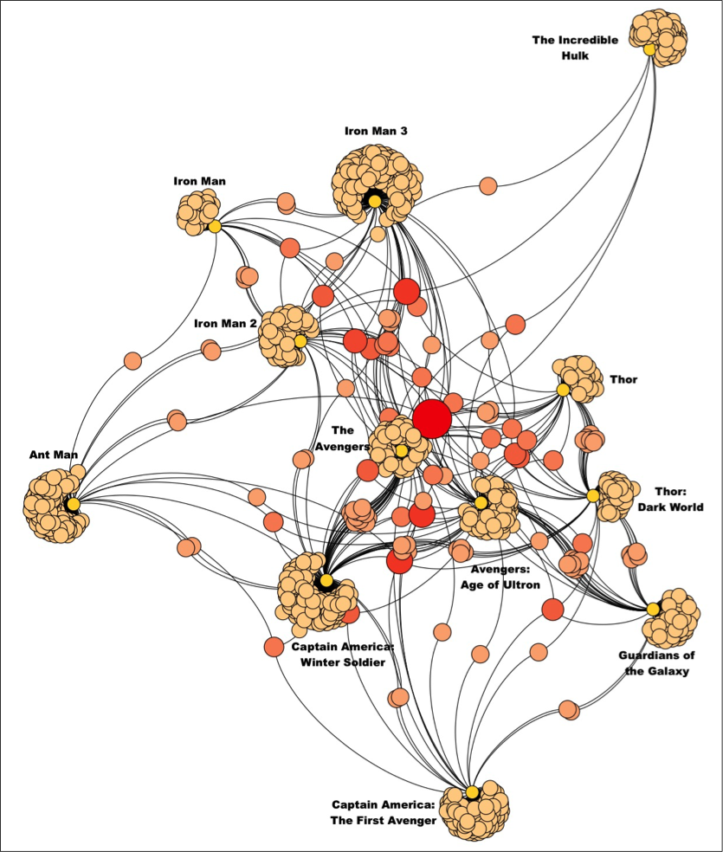
What is an affiliation network?
Types of affiliation networks that have been studied in the literature include:
  Hollywood actors and the movies that they make
  CEOs and the board of directors that they sit on
  Books and the people who buy them
  Scientists and the journal they publish in

Slide 39
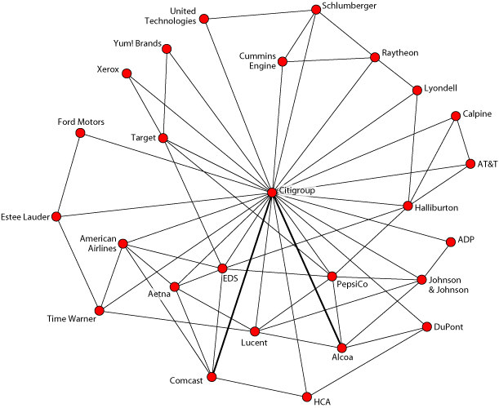
What is an affiliation network?
Types of affiliation networks that have been studied in the literature include:
  Hollywood actors and the movies that they make
  CEOs and the board of directors that they sit on
  Books and the people who buy them
  Scientists and the journal they publish in

Slide 40
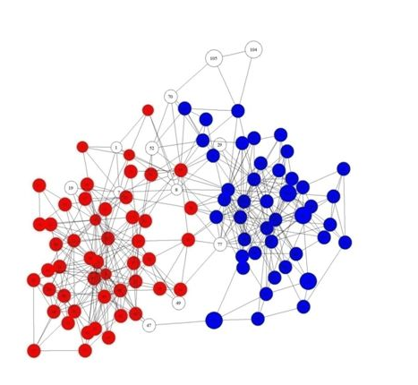
What is an affiliation network?
Types of affiliation networks that have been studied in the literature include:
  Hollywood actors and the movies that they make
  CEOs and the board of directors that they sit on
  Books and the people who buy them
  Scientists and the journal they publish in

Slide 41
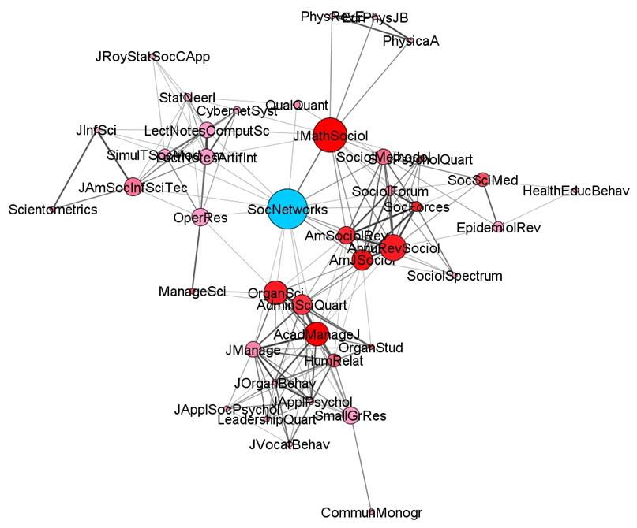
What is an affiliation network?
Types of affiliation networks that have been studied in the literature include:
  Hollywood actors and the movies that they make
  CEOs and the board of directors that they sit on
  Books and the people who buy them
  Scientists and the journal they publish in

Slide 42
What is an affiliation network?
Types of affiliation networks that have been studied in the literature include:
  Hollywood actors and the movies that they make
  CEOs and the board of directors that they sit on
  Books and the people who buy them
  Scientists and the journal they publish in

Slide 43
Glossary of Key Terms (Two-Mode Networks)
Two-mode network: A social network in which two types of entities (e.g., people and the books they bought) are linked together
Affiliation network: A type of two-mode networks in which people are linked to the groups they belong to (are affiliated with)
Bipartite Graph: A graph with two disjoint set of nodes in which nodes link only to nodes in the other set but not with nodes in their own set
  Bipartite graphs are useful for representing two-mode networks!
Affiliation Matrix: Matrix recording the adjacency relations between vertices in a bipartite graph representing a two-mode network

Slide 44
Glossary of Key Terms (Two-Mode Networks)
Matrix Transpose: A matrix operation that produces a new matrix (the transpose) by switching around the number of rows and the number of columns of the original matrix
Co-membership Matrix: Matrix that results from multiplying an affiliation matrix times its transpose. The off-diagonal cells of the co-membership matrix records the number of shared memberships each pair of people have in an affiliation network.
Group Overlap Matrix: Matrix that results from multiplying the transpose of an affiliation matrix times the original. The off-diagonal cells of the group overlap matrix records the number of shared members each pair of groups have in an affiliation network.

